Slide 1
CHAPTER 5 part 2
DATA COMMUNICATION
Prepared by:Ahmed AL-Ashoor

Slide 2
Working Computing
Working Computing
Means that the user at a network can use his own computer to do his tasks
The benefits of this technique are: -
1. Sharing of files, documents, & resources.
2. Sending messages to all the people on the network at the same time.
3. Sharing software.
4. Sharing equipment’s

Slide 3
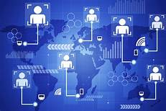
Internet
Global network consisting of thousands of public and private networks of varying sizes; it is linked by a set of standard communications protocols.

Slide 4
Type of Network according to their Geographical distance
Local area network (LAN).
a. Server / clients network.
b. Peer – to – peer network.
C- Wireless local area network (WLAN).
Wide Area Network (WAN).
a-HUB b-Switchers c-Routers
d-Gateway e-Bridge f-Repeaters
g-Multipliers

Slide 5
Local area network (LAN)
A number of computers linked together by cables in a limited area(same building). Is a computer network that interconnects computers in a limited area such as a home, school, computer laboratory, or office building using network media

Slide 6
Local area network (LAN)
Server / clients network:-
Computer called server store common data which it serves to other computers called clients

Slide 7
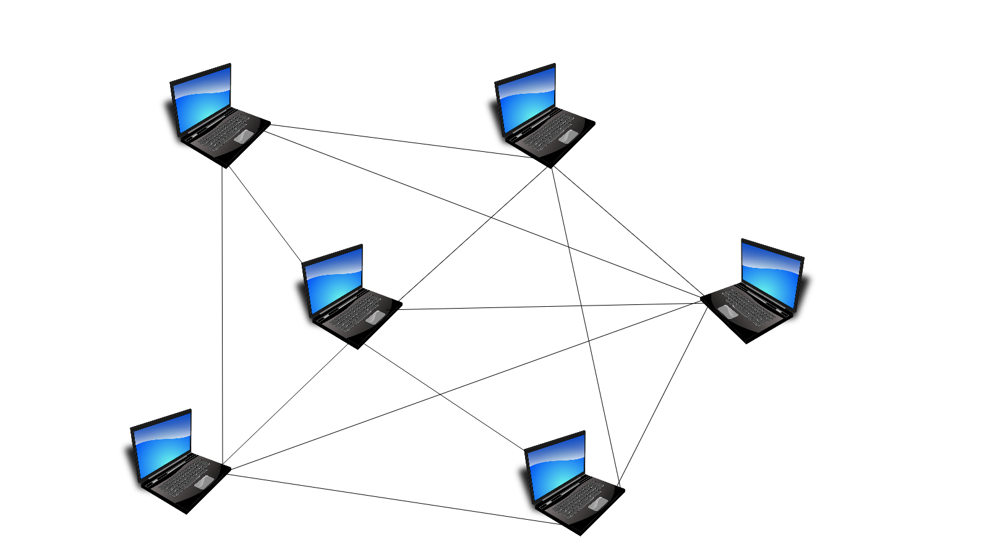
Local area network (LAN)
Peer – to – peer network:-
Does not use server, individual computers share data directly with other computers

Slide 8
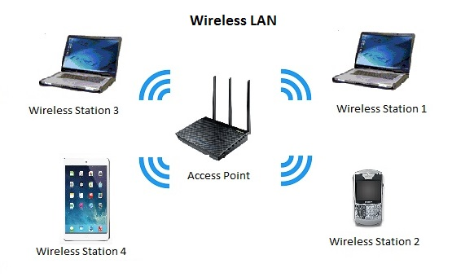
Local area network (LAN)
Wireless local area network (WLAN): -
links two or more devices using some wireless distribution method.
Wireless LANs have become popular in the home due to ease of installation, and in commercial complexes offering wireless access to their customers;
often for free.

Slide 9
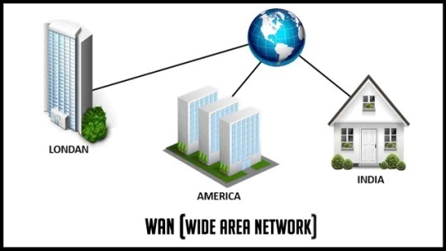
Wide Area Network (WAN)
Network that connect computers over large area by satellite communication, WAN is used to connect offices of an organization that are located in different cities in the same country or in different countries, also WAN used to connect the Bank machine, telephone
system.

Slide 10
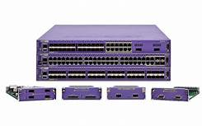
WAN devices: -
HUB: a distributer that has a lot of port which connected to computer .OR.Unit that receives all messages sent by the devices connected to it and
redistributes them to all users.

Slide 11
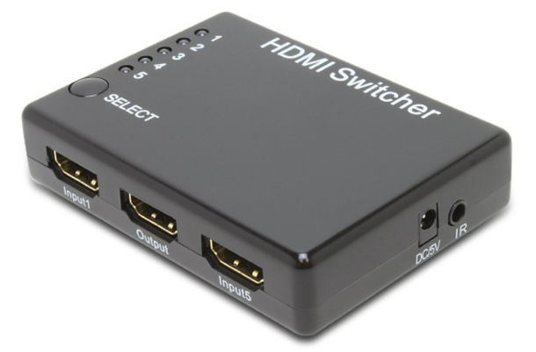
WAN devices: -
Switchers: like a HUB, but it transmits its packet to its destination.
It also handles traffic between the various parts of a network.

Slide 12
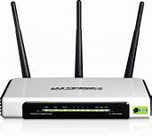
WAN devices: -
Routers: This is a hardware device that routes data (hence the name) from a local area network (LAN) to another network connection.

Slide 13
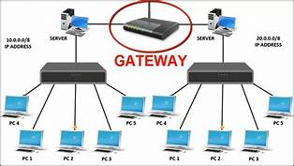
WAN devices: -
Gateway: it is used to connect to different LANs.

Slide 14
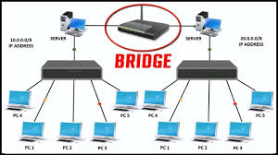
WAN devices: -
Bridge: it is used to connect two similar LANs.

Slide 15
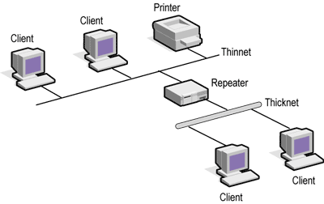
WAN devices: -
Repeaters: repeat signals that travel via long distance. Device running the length of a cable that receives amplifies and resends signals to transmit them
over long distances.

Slide 16
WAN devices: -
Multipliers: combines messages of several devices and sends them a long a single high speed path.

Slide 17
Network topologies
There are three main topologies for computers: -
1. Star network: star network- Network in which all devices are connected to a central unit in the shape of a star.

Slide 18
Network topologies
2. Ring network: Network in which all devices are connected to a ring;messages travel from one device to another in a set direction until they reach the intended receiver.

Slide 19
Network topologies
3. Bus network: Network in which all devices are connected to acommon bus; the same message is sent to all of them but only one receives and registers it.

Slide 20
Data communication hardware
1. Modem “Modulate / Demodulate”
2. Network interface card.
3. Transmission media.

Slide 21
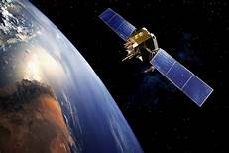
Satellite
Satellite. Telecommunications by satellite Transmission of data such as images, sound and computer data using radio waves relayed by satellites.

Slide 22
Network protocol
Network protocol
Set of instruction and procedures that maintain and control transmission in network, it decides number of computers that can be connected, how error can be fixed and how the transmission will be occurred.

